Slide 1
Module-5: Data Visualization with NumPy Arrays, Matplotlib, and Seaborn: Data Visualization: Matplotlib package – Plotting Graphs – Controlling Graph – Adding Text – More Graph Types – Getting and setting values – Patches. Advanced data visualization with Seaborn.- Time series analysis with Pandas.

Slide 2
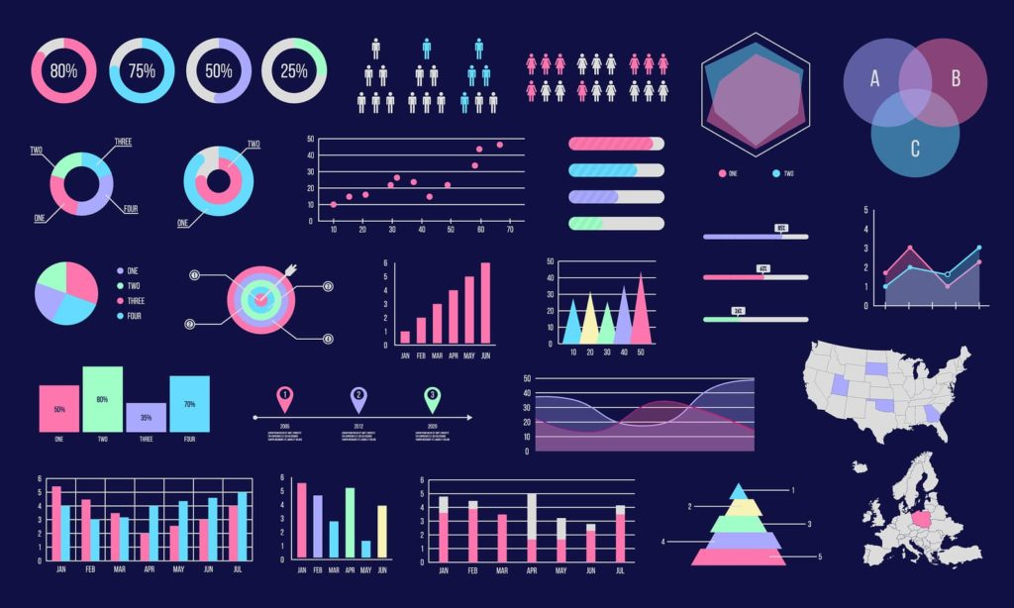
Numpy
Data
Matplotlib
Visualization

Slide 3
Data Visualization:
Data Visualization is the graphical representation of data and information. It helps in identifying trends, patterns, and insights in large datasets by using visual elements like charts, graphs, maps, and dashboards.
Why is Data Visualization Important?
Better Data Understanding – Makes complex data easier to comprehend.
Identifies Trends and Patterns – Helps spot correlations and anomalies quickly.
Improves Decision Making – Supports data-driven business strategies.
Enhances Communication – Presents data effectively for both technical and non-technical audiences.

Slide 4
Common Data Visualization Types
Bar Chart – Compares different categories.
Line Chart – Shows trends over time.
Pie Chart – Represents proportions.
Scatter Plot – Displays relationships between variables.
Heatmap – Highlights data intensity with color variations.
Histogram – Represents frequency distribution.
Dashboard – Combines multiple visualizations for an overview.

Slide 5
Popular Data Visualization Tools
Tableau
Power BI
Matplotlib & Seaborn (Python)
D3.js (JavaScript)
Google Data Studio

Slide 6
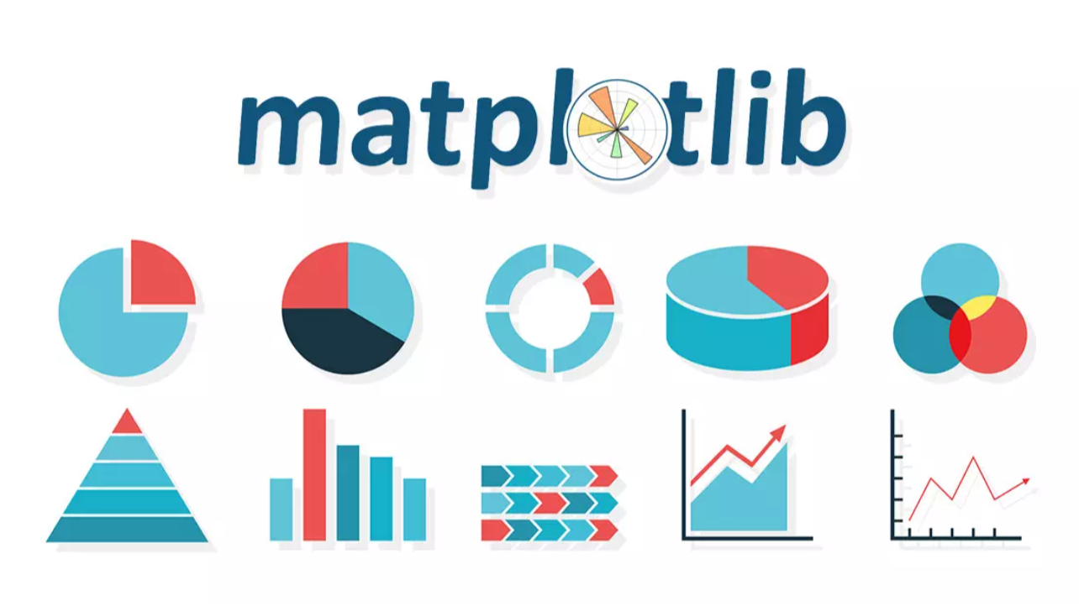

Slide 7
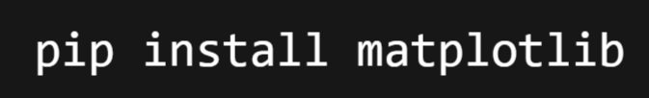

Matplotlib
Matplotlib is one of the most widely used Python libraries for data visualization. It provides tools to create static, animated, and interactive plots with a high degree of customization. It is particularly useful for plotting datasets in a variety of formats.
Installation: You can install Matplotlib using pip:
Importing Matplotlib:

Slide 8
Matplotlib Package:
Matplotlib provides functionalities to create various types of charts, graphs, and plots to visualize data effectively. It is particularly useful for scientific computing, machine learning, and statistical analysis.
Key Features of Matplotlib:
✅ Supports line plots, bar charts, histograms, scatter plots, pie charts, 3D plots, and more.
✅ Customizable plots with labels, legends, colors, styles, and annotations.
✅ Can save plots in PNG, JPG, PDF, SVG, etc.
✅ Works well with NumPy, Pandas, and SciPy.
✅ Allows interactive plotting using plt.ion().

Slide 9
Basic Structure of a Matplotlib Plot
Every Matplotlib plot consists of the following core components:
Figure (Figure): The entire canvas or window where graphs are drawn.
Axes (Axes): A subplot or graph area inside the figure.
X-axis & Y-axis: Coordinate axes for plotting data.
Plot (plot()): The graphical representation of data.
Labels & Titles (xlabel(), ylabel(), title()): Used for descriptive elements.
Legend (legend()): Displays the label for each plotted dataset.
Grid (grid()): Adds a reference grid to the plot.
Ticks & Tick Labels (xticks(), yticks()): Customizes axis labels.

Slide 10
Plotting Graphs:
Matplotlib is a powerful Python library used for data visualization. It allows us to create various types of plots, including line graphs, bar charts, histograms, scatter plots, and more.

Slide 11
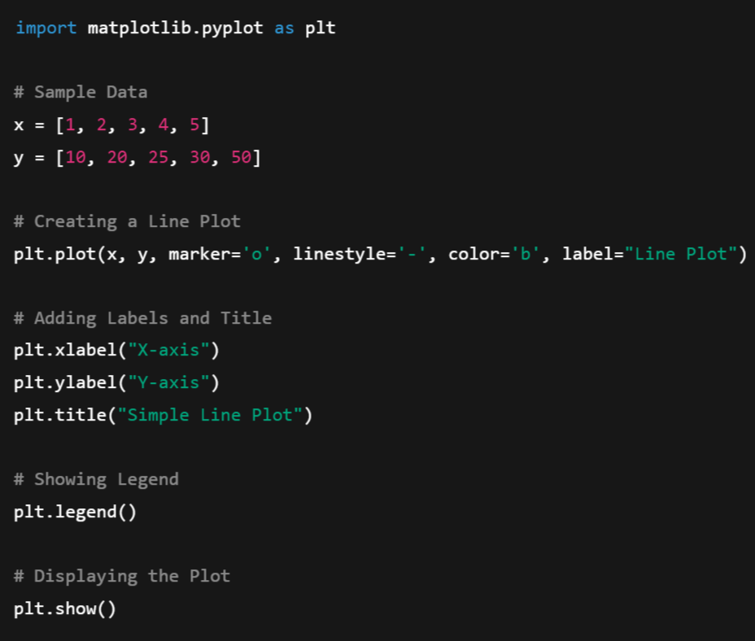
Basic Plotting:
A simple example to create a line plot

Slide 12
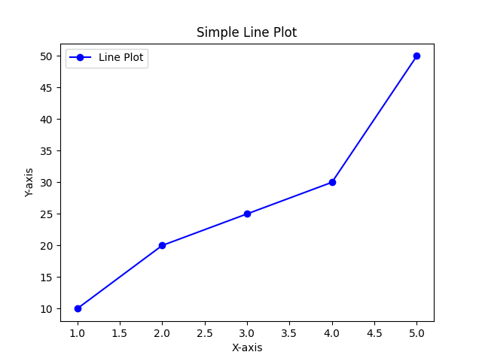

Slide 13
Syntax Explanation:
The plt.plot() function is used to create line plots in Matplotlib. It takes various arguments to control how the plot appears.
x, y: These are the data points for the x-axis and y-axis, respectively. Matplotlib connects these points with a line.
marker='o': Specifies the marker style for each data point. 'o' represents circular markers.
Other common marker styles: 's' → Square, '^' → Triangle, 'x' → Cross, 'd' → Diamond, '*' → Star
linestyle='-': Defines the style of the line connecting data points. Common styles: '-' → Solid line, '--' → Dashed line, ':' → Dotted line, '-.' → Dash-dot line
color='b': Sets the line color. 'b' stands for blue. Other color codes: 'r' → Red, 'g' → Green, 'y' → Yellow, 'k' → Black, 'c' → Cyan, 'm' → Magenta, You can also use hex codes like color='#ff5733'.

Slide 14
Controlling Graphs in Matplotlib
Matplotlib provides various ways to control and customize graphs. You can modify figure size, line styles, colors, axes, legends, grids, and more.
Controlling Figure Size
Controlling Line Style, Color, and Markers
Controlling Axis Range
Controlling Grid Lines
Controlling Ticks and Labels
Controlling Legends
Adding Annotations to Graphs

Slide 15
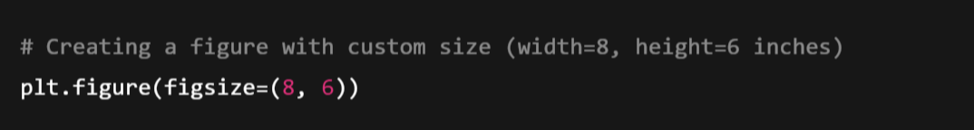
1. Controlling Figure Size
You can adjust the size of the figure using figsize inside plt.figure() or plt.subplots().
Example:
🔹 figsize=(8,6) sets the figure width to 8 inches and height to 6 inches.

Slide 16
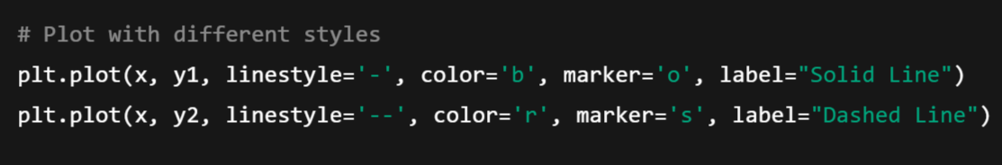
2. Controlling Line Style, Color, and Markers
Matplotlib allows you to modify line color, style, and markers.
Example:
🔹 Customizations Used:
linestyle='-' → Solid line
linestyle='--' → Dashed line
color='b' → Blue color
color='r' → Red color
marker='o' → Circle markers
marker='s' → Square markers

Slide 17
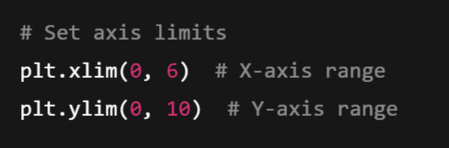
3. Controlling Axis Range
You can manually set the x-axis and y-axis limits using plt.xlim() and plt.ylim().
Example:
🔹 Customizations Used:
plt.xlim(0, 6) → X-axis from 0 to 6
plt.ylim(0, 10) → Y-axis from 0 to 10

Slide 18
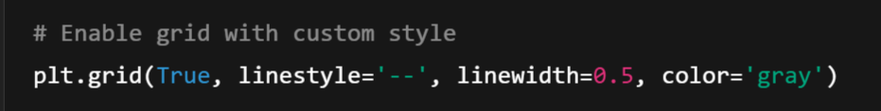
4. Controlling Grid Lines
You can enable or modify grid lines using plt.grid().
Example:
🔹 Customizations Used:
plt.grid(True) → Enables grid
linestyle='--' → Dashed grid lines
linewidth=0.5 → Thin grid lines
color='gray' → Gray-colored grid

Slide 19
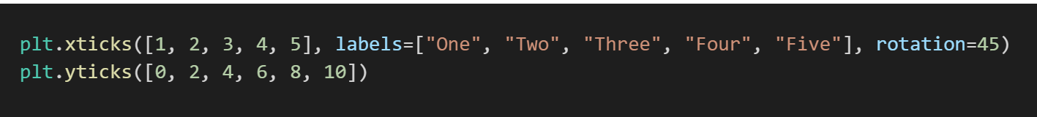
5. Controlling Ticks and Labels
You can control ticks, rotation, and format using plt.xticks() and plt.yticks().
Example:
🔹 Customizations Used:
plt.xticks([1,2,3,4,5], labels=["One","Two","Three","Four","Five"]) → Custom x-axis labels.
rotation=45 → Rotates x-axis labels.

Slide 20
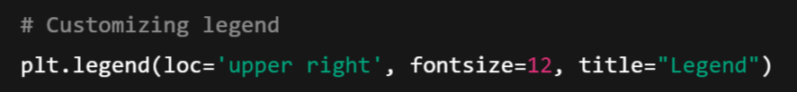
6. Controlling Legends
Legends help differentiate multiple plots in a graph.
Example:
🔹 Customizations Used:
plt.legend(loc='upper right') → Places legend at the upper-right.
fontsize=12 → Sets font size.
title="Legend" → Adds a title to the legend.

Slide 21
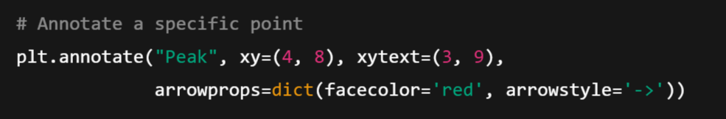
7. Adding Annotations to Graphs:
You can add text or arrows to highlight important points using plt.annotate().
Example:
🔹 Customizations Used:
plt.annotate("Peak", xy=(4,8), xytext=(3,9), arrowprops=dict(facecolor='red', arrowstyle='->')) → Annotates point (4,8) with an arrow.

Slide 22
Adding Text in Matplotlib 📊📝
In Matplotlib, you can add text annotations to plots using different methods:
plt.text() → Adds text at a specific location in the plot.
plt.annotate() → Adds text with an arrow pointing to a specific data point.
plt.title(), plt.xlabel(), plt.ylabel() → Adds titles and axis labels.

Slide 23
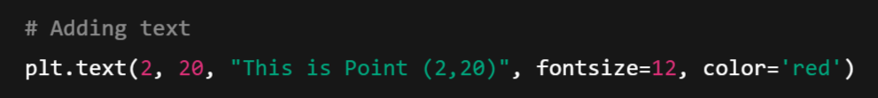
1️⃣ Adding Text Using plt.text():
The plt.text(x, y, "Text") function allows you to place text anywhere in the graph.
Example:
🔹 Explanation:
✅ plt.text(2, 20, "This is Point (2,20)") → Adds text at (x=2, y=20).
✅ fontsize=12 → Sets font size.
✅ color='red' → Changes text color.

Slide 24
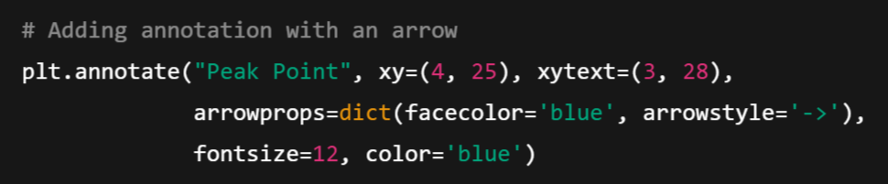
2️⃣ Adding Annotations Using plt.annotate()
The plt.annotate() function is useful for adding text with arrows to highlight specific points.
Example:

Slide 25
🔹 Explanation:
✅ xy=(4, 25) → Arrow points to (4,25).
✅ xytext=(3, 28) → Text is placed at (3,28).
✅ arrowprops=dict(facecolor='blue', arrowstyle='->') → Creates a blue arrow.
✅ fontsize=12, color='blue' → Sets font size and color.

Slide 26
3️⃣ Adding Titles and Labels:
You can add a title, x-axis label, and y-axis label using:
plt.title()
plt.xlabel()
plt.ylabel()
Example:

Slide 27
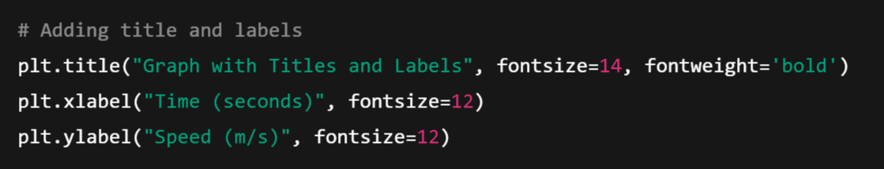
🔹 Explanation:
✅ plt.title("Graph with Titles and Labels", fontsize=14, fontweight='bold') → Adds bold title.
✅ plt.xlabel("Time (seconds)", fontsize=12) → Labels x-axis.
✅ plt.ylabel("Speed (m/s)", fontsize=12) → Labels y-axis.

Slide 28
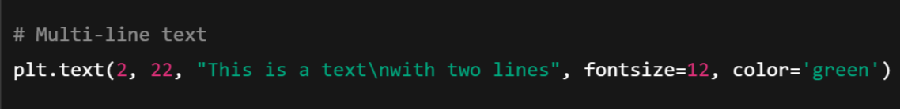
4️⃣ Adding Multi-line Text
If you need multi-line text, use \n (newline character) inside plt.text().
Example:

Slide 29
Different Graph Types in Matplotlib 🎨📊
Matplotlib provides various types of graphs for visualizing data. The most commonly used graph types include:
1️⃣ Line Graph → plt.plot()
2️⃣ Bar Chart → plt.bar() (vertical) & plt.barh() (horizontal)
3️⃣ Histogram → plt.hist()
4️⃣ Scatter Plot → plt.scatter()
5️⃣ Pie Chart → plt.pie()
6️⃣ Box Plot (Box-and-Whisker Plot) → plt.boxplot()

Slide 30
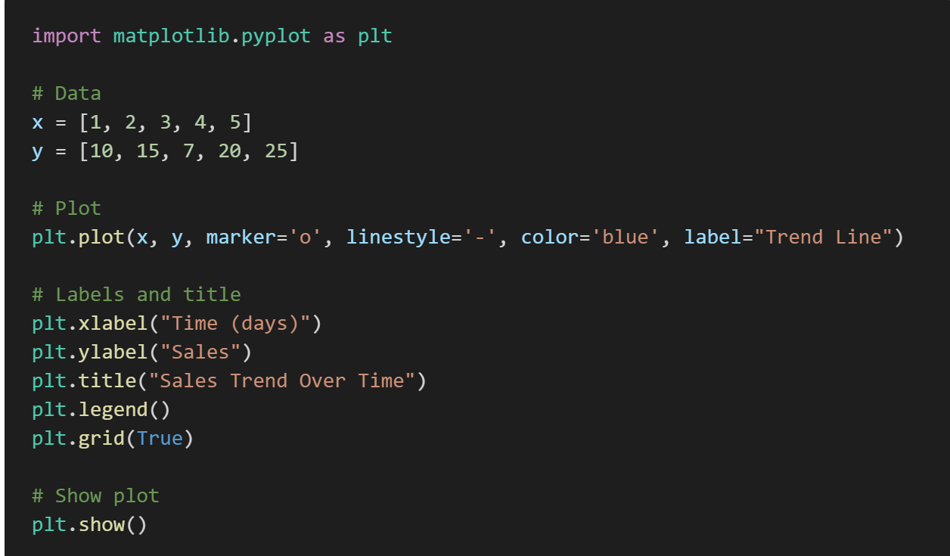
1️⃣ Line Graph (plt.plot):
Used to visualize trends over time.
Example:

Slide 31
🔹 Explanation:
✅ marker='o' → Adds dots at each data point.
✅ linestyle='-' → Connects points with a line.
✅ plt.grid(True) → Adds grid for better readability.

Slide 32
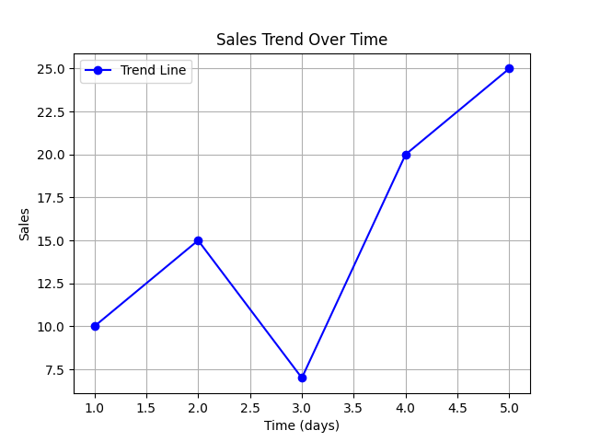

Slide 33
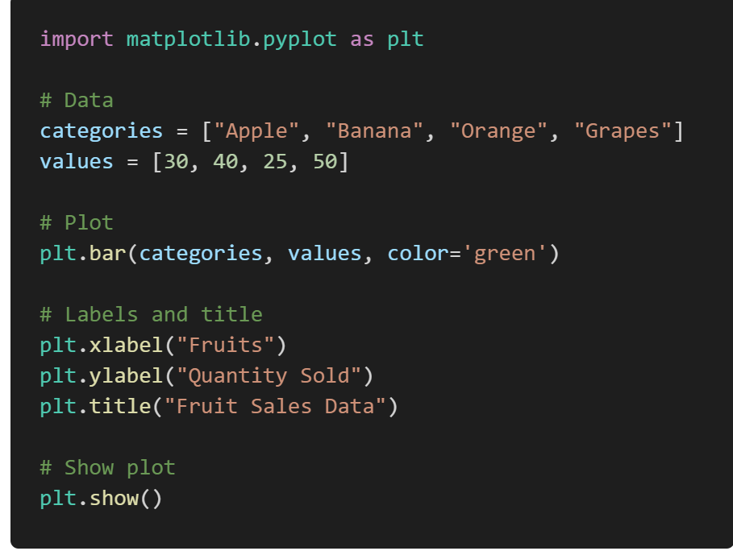
2️⃣ Bar Chart (plt.bar & plt.barh): Used to compare categories.
Example (Vertical Bar Chart):
✅ plt.bar() → Vertical bars.
✅ plt.barh() → Horizontal bars.

Slide 34
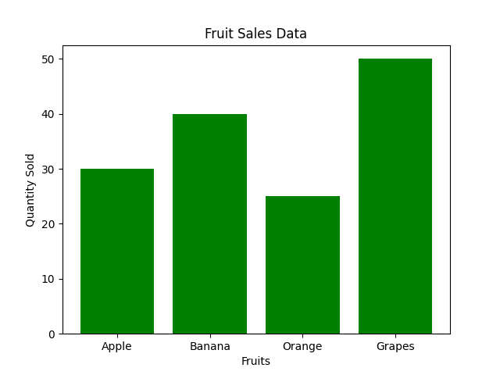

Slide 35
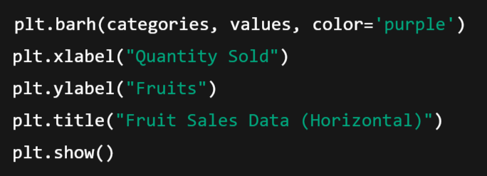
Example (Horizontal Bar Chart)

Slide 36
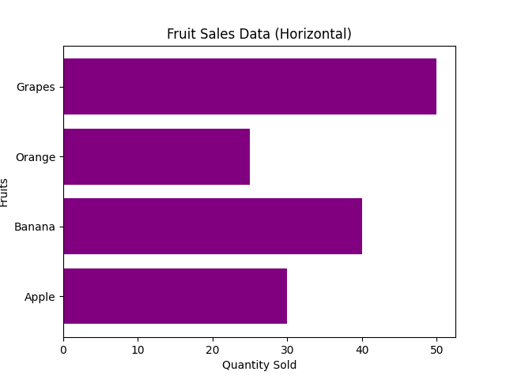

Slide 37
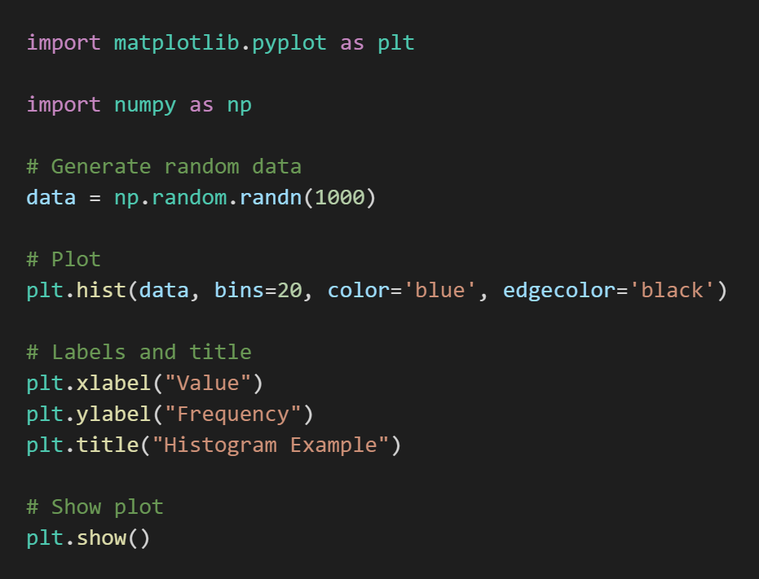
3️⃣ Histogram (plt.hist): Used to visualize data distribution.
Example:
🔹 Explanation:
✅ bins=20 → Defines the number of bars (bins).
✅ np.random.randn(1000) → Generates 1000 random numbers.

Slide 38
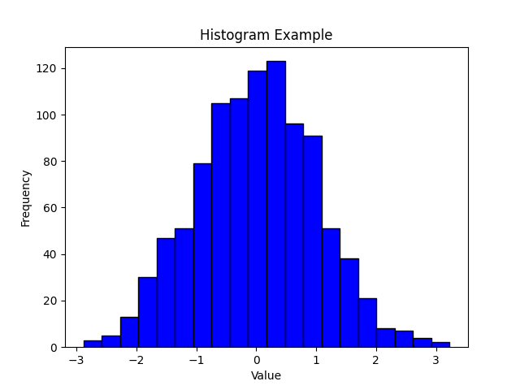

Slide 39
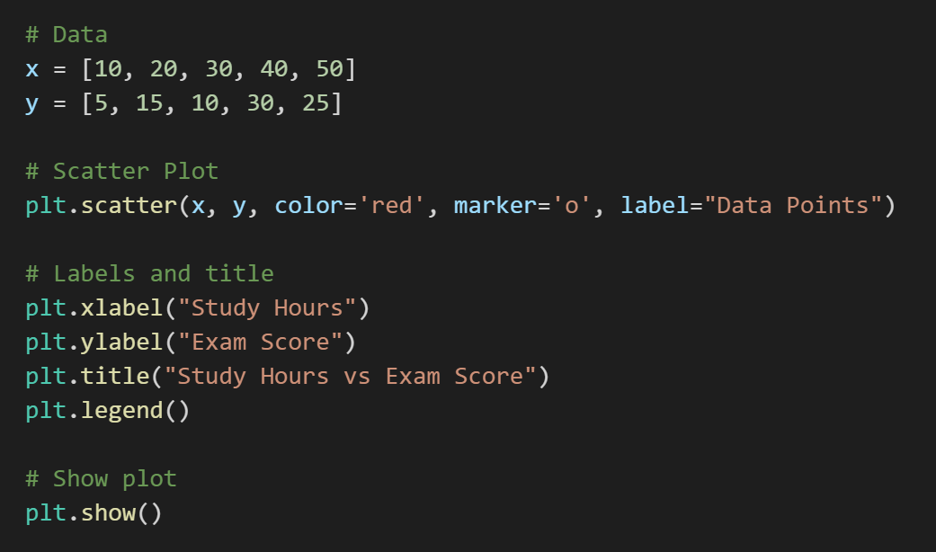
4️⃣ Scatter Plot (plt.scatter) Used to show the relationship between two variables.
Example:

Slide 40
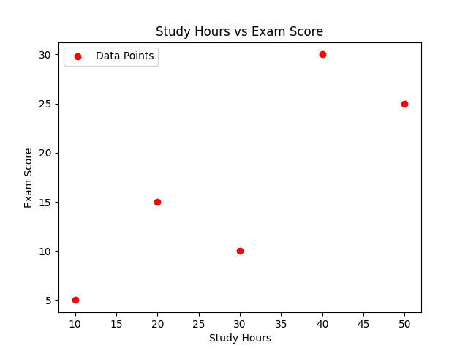

Slide 41
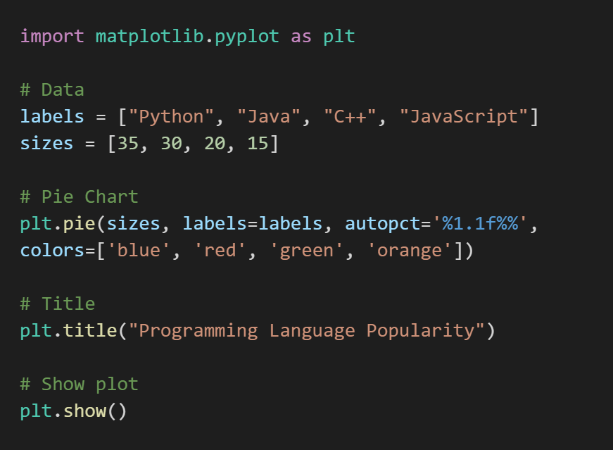
5️⃣ Pie Chart (plt.pie): Used for percentage-based data.
Example:
✅ autopct='%1.1f%%’ →
Displays percentage values.

Slide 42
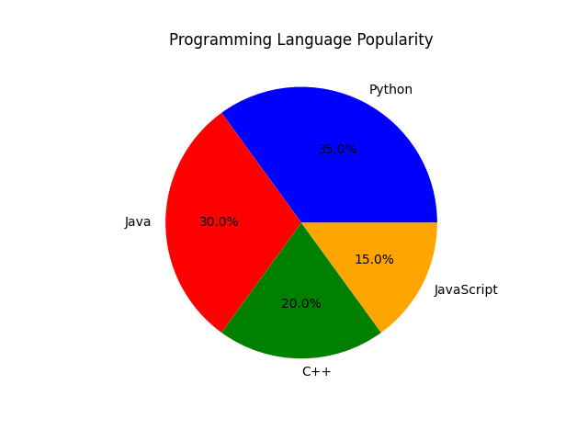

Slide 43
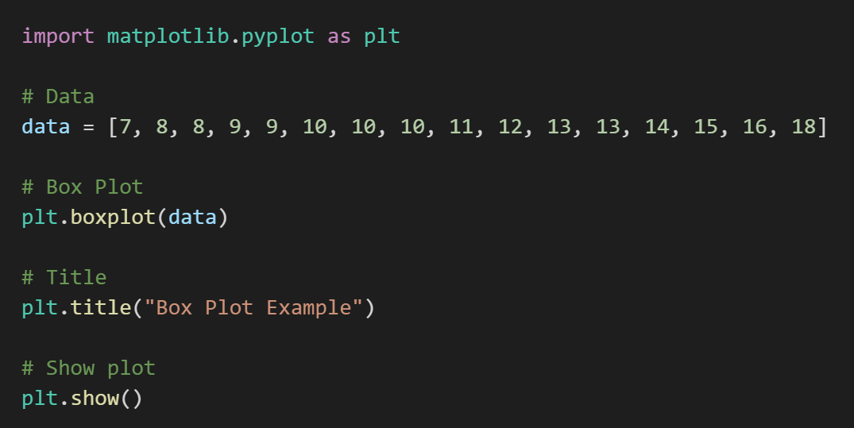
6️⃣ Box Plot (plt.boxplot): Used to show the distribution of data.
Example:

Slide 44
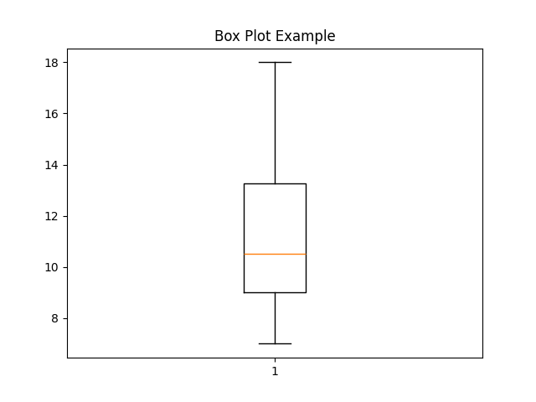
🔹 Explanation:
✅ Box plot shows median, quartiles, and outliers.

Slide 45
Getting and setting values:
In Matplotlib, we often want to:
✅ Get values (like current x/y limits, labels, titles, etc.)
✅ Set values (like changing axis labels, limits, tick marks, titles, etc.)

Slide 46
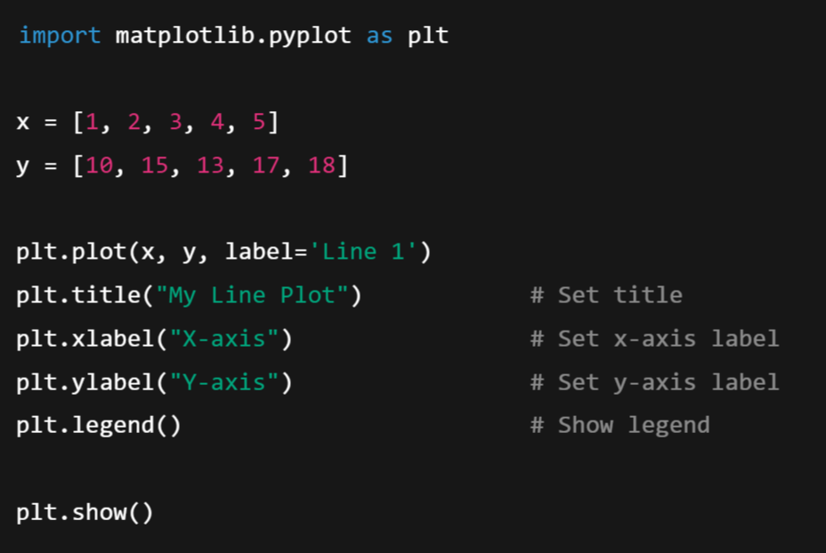
✅ 1. Setting Values (Using Setter Methods)
➤ 1.1 Set Title, Labels, and Legend:

Slide 47
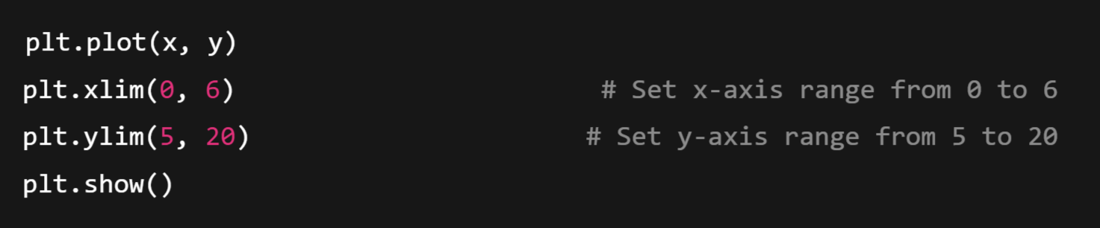
➤ 1.2 Set X and Y Limits:

Slide 48
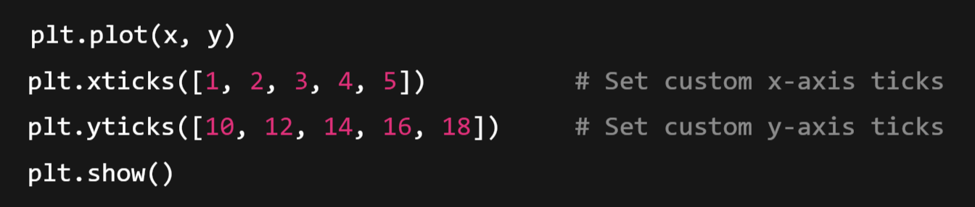
➤ 1.3 Set Ticks

Slide 49
✅ 2. Getting Values (Using Getter Methods)
Once you've created a plot, you might want to get current settings like title, labels, limits, etc.

Slide 50
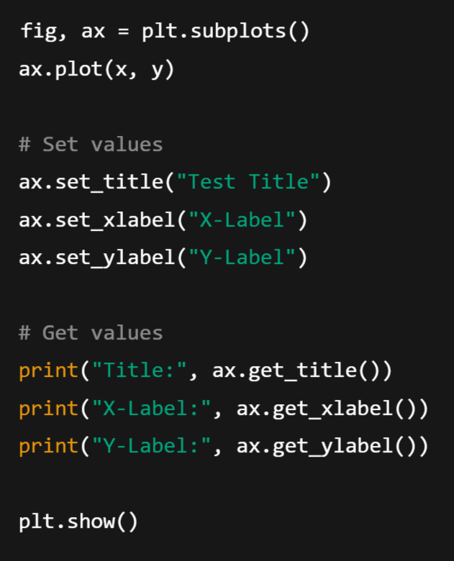
➤ 2.1 Getting Title and Labels
fig, ax = plt.subplots() – Object-Oriented Interface
This is the object-oriented (OO) approach, where:
fig → represents the whole figure (canvas).
ax → represents a single plot (subplot).
🔸 It gives you more control, better customization, and is great when you work with multiple plots.

Slide 51
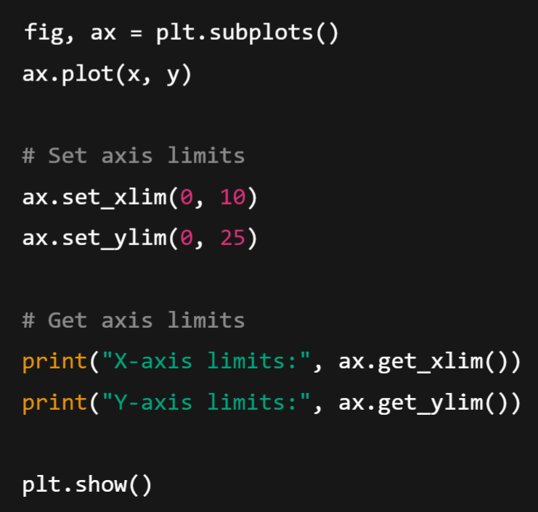
➤ 2.2 Getting Axis Limits

Slide 52
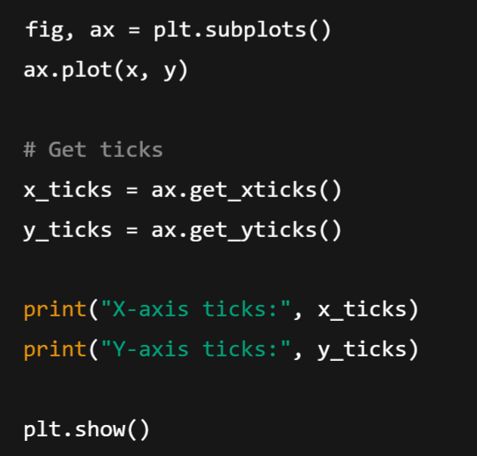
➤ 2.3 Getting Ticks and Tick Labels

Slide 53
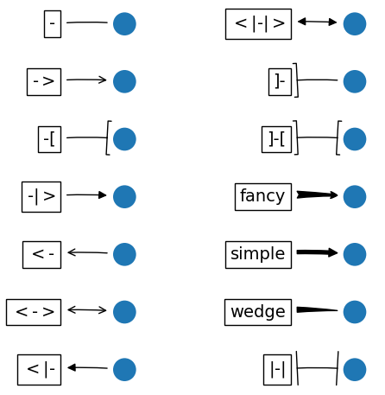
🧩 Patches in Matplotlib?
In Matplotlib, a Patch is a 2D shape used to draw things like:
✅ Circles
✅ Rectangles
✅ Polygons
✅ Ellipses
✅ Arrows
✅ Wedges (like pie chart slices)
... and more.
They are part of the matplotlib.patches module and are used to manually draw shapes on a plot or figure.

Slide 54
🔧 Why Use Patches?
Patches are helpful when you want to:
Highlight a specific region.
Overlay custom shapes.
Create custom legends or markers.
Make geometric art or annotate specific points.

Slide 55
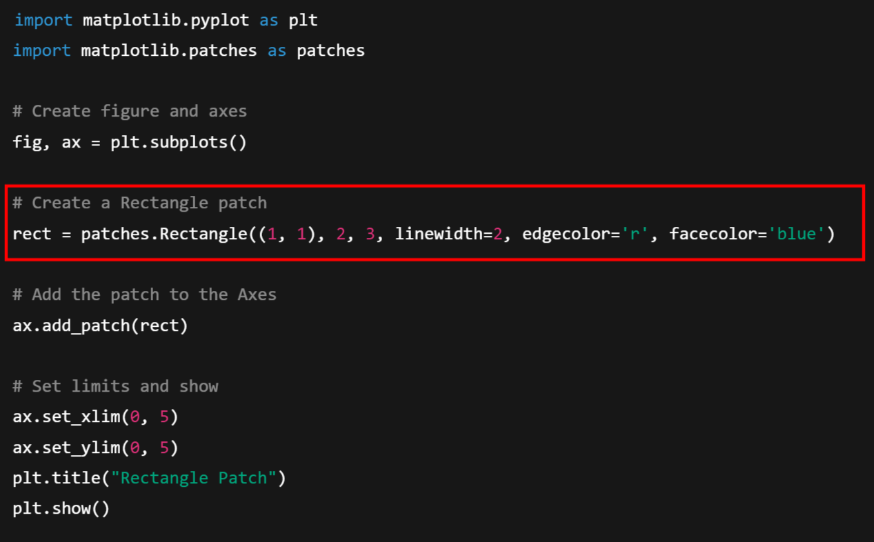
🧪 Example: Drawing a Rectangle with Patch

Slide 56
Where ,
🎨 So this rectangle starts at point (1,1), goes 2 units to the right, and 3 units up.
Argument | Meaning
(1, 1) | Bottom-left corner of the rectangle (x=1, y=1)
2 | Width of the rectangle (along x-axis)
3 | Height of the rectangle (along y-axis)
linewidth=2 | Border thickness
edgecolor='r' | Border color is red
facecolor='blue' | Fill color is blue

Slide 57
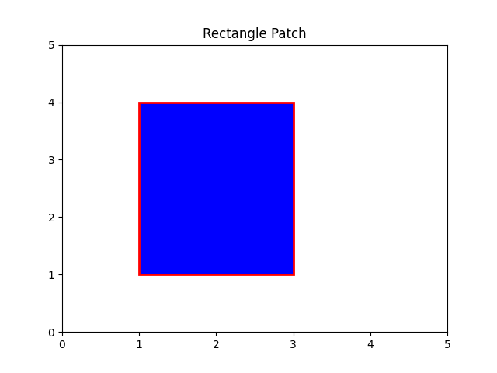

Slide 58
✅ Commonly Used Patches:
Patch Type | Class | Use
Rectangle | patches.Rectangle | Boxes, bars
Circle | patches.Circle | Dots, bubbles
Ellipse | patches.Ellipse | Ovals
Polygon | patches.Polygon | Custom closed shapes
FancyArrow | patches.FancyArrow | Arrows
Wedge | patches.Wedge | Pie chart slices

Slide 59
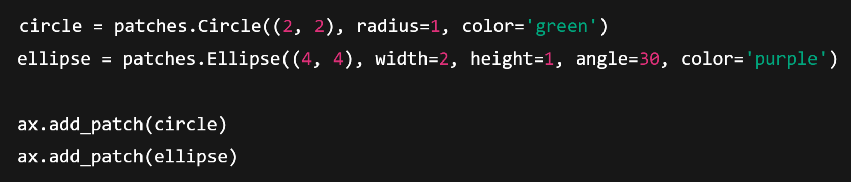
🔄 Example: Circle and Ellipse

Slide 60
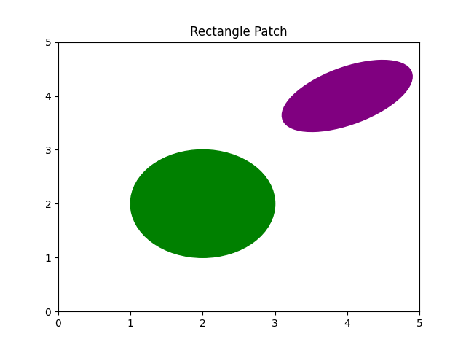

Slide 61
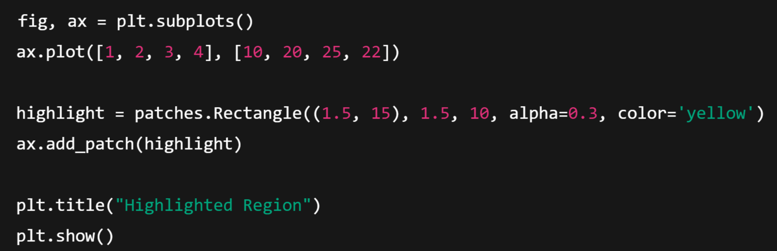
🎯 Real Use Case: Highlight a Region

Slide 62
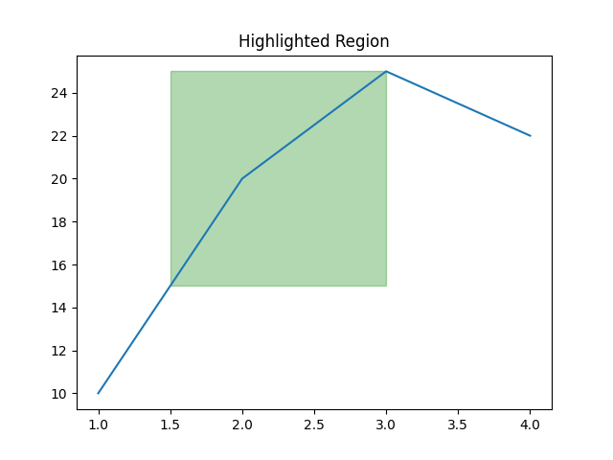

Slide 63
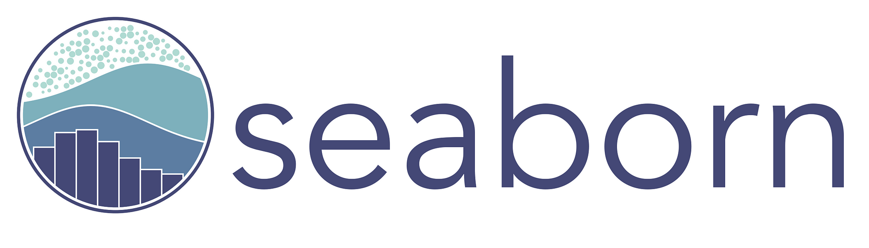
🌊 What is Seaborn?
Seaborn is a Python visualization library built on top of Matplotlib. It integrates closely with Pandas and is designed for statistical data visualization.
✅ Why Use Seaborn?
High-level API for complex plots
Built-in themes and color palettes
Easy integration with Pandas DataFrames
Automatic handling of grouping, aggregation, and statistical estimation

Slide 64

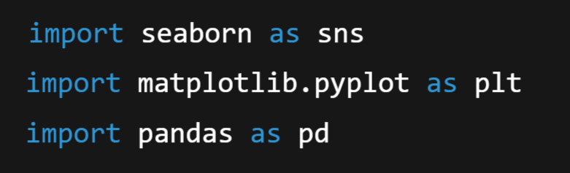
🔧 Setup:

Slide 65
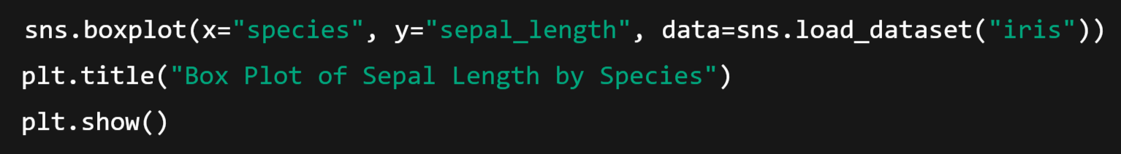
🧠 Advanced Seaborn Features:
1. Categorical Plots – Visualize relationships between categorical and numerical variables
📌 a) boxplot():

Slide 66
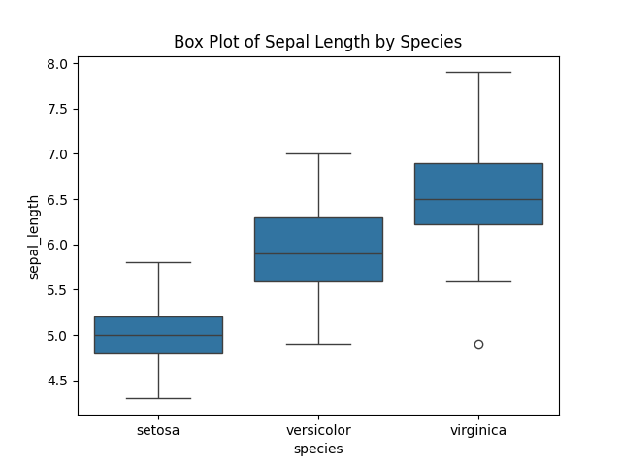
Output:

Slide 67
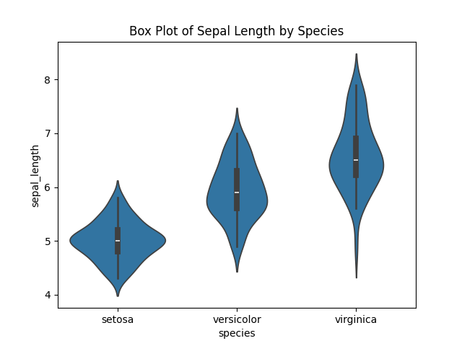
📌 b) violinplot():

Slide 68
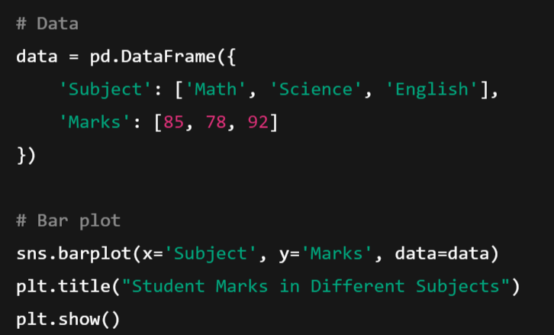
1️⃣ Categorical Plots: barplot, boxplot, violinplot
📊 Example: Student Scores in Subjects

Slide 69
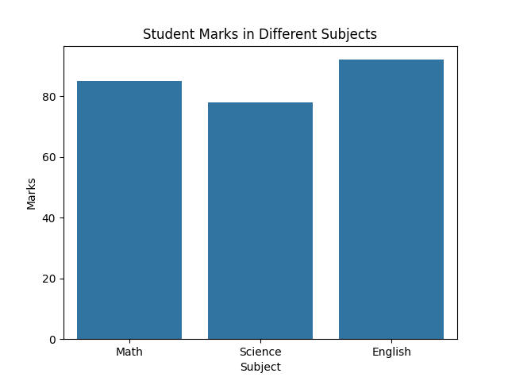
Output:
✅ What It Shows:
X-axis: Subjects
Y-axis: Marks scored
Each bar represents how much the student scored in that subject.
🟦 Tallest bar = Highest marks → English (92)

Slide 70

2️⃣ Histogram + KDE (Kernel Density Estimation)
🍕 Example: Pizza Delivery Times (in minutes)

Slide 71

✅ What It Shows:
Groups delivery times into ranges (bins) like 28–30, 31–33, etc.
KDE line shows the smooth distribution.
Most deliveries take around 30–32 minutes.

Slide 72

3️⃣ Box Plot:
🧪 Example: Test Scores in Two Classes

Slide 73

✅ What It Shows:
Box = 50% of scores (middle range)
Line inside = Median
Dots outside = Outliers
Class A has higher scores and less variation than Class B

Slide 74

4️⃣ Violin Plot:
Same data as box plot, but prettier and shows data distribution:

Slide 75

✅ What It Shows:
Wider parts = more students scored in that range
Smarter alternative to box plot when data is small

Slide 76

5️⃣ Scatter Plot + Line Plot
📚 Real-life Example: Study Hours vs Marks

Slide 77

✅ What It Shows:
Each dot = a student
Clear positive relationship: more hours → higher marks
Line helps visualize trend

Slide 78

6️⃣ Catplot
☕ Example: Coffee Sales by Day and Cup Size

Slide 79

✅ What It Shows:
Bars grouped by day and cup size
Large cups are more popular every day!

Slide 80

7️⃣ Heatmap:
📋 Example: Student Marksheet

Slide 81

✅ What It Shows:
Grid view: subjects vs students
Colors show marks → darker = higher
Student C scored highest in Math & English

Slide 82
Time series analysis with Pandas:
🕰️ What is Time Series Analysis?
Time Series is a series of data points collected or recorded at regular time intervals (daily, monthly, yearly).
Examples:
Daily temperature
Monthly sales
Hourly website visitors

Slide 83
📦 Why Use Pandas?
Pandas makes time series analysis easy by:
Handling dates as index
Providing tools for resampling, shifting, rolling averages, etc.
Handling missing dates or time gaps

Slide 84

✅ Example: Daily Sales Over 10 Days
🔧 Step 1: Import Libraries & Create Data

Slide 85

📈 Step 2: Plot the Time Series

Slide 86

🔁 Step 3: Resampling (e.g., Weekly Sales Total)
🟢 Explanation:
'W' stands for Weekly
Adds up all sales in each week

Slide 87

🎯 Step 4: Rolling Mean (Moving Average)

Slide 88

🟢 Explanation:
Smoother curve that helps find trends
A 3-day rolling average shows average of the last 3 days

Slide 89

🕒 Step 5: Time Shifting (Forecast Simulation)
shift(1) moves values forward
Helps compare today's sales vs yesterday’s

Slide 90

Output:

Slide 91
Module-5: Data Visualization with NumPy Arrays, Matplotlib, and Seaborn: Data Visualization: Matplotlib package – Plotting Graphs – Controlling Graph – Adding Text – More Graph Types – Getting and setting values – Patches. Advanced data visualization with Seaborn.- Time series analysis with Pandas.

